Slide 1
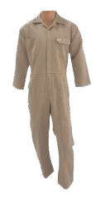
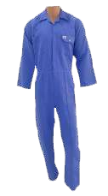
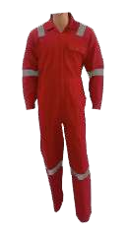
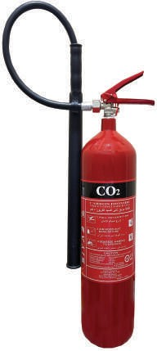
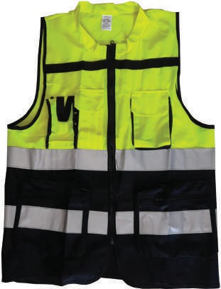
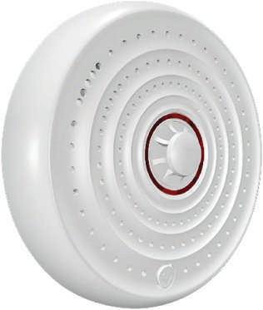
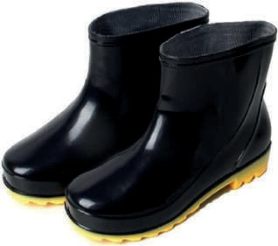
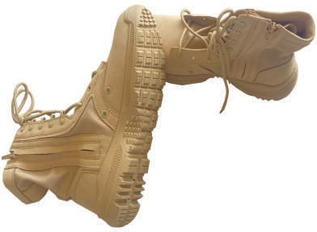

Slide 2
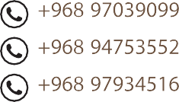
siyab.oman

Slide 3
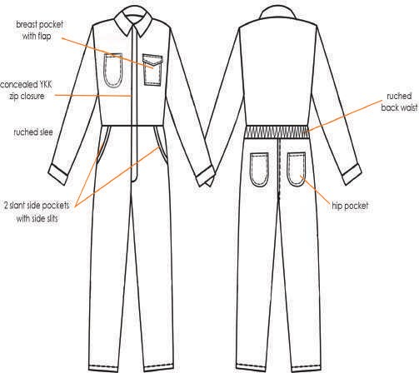
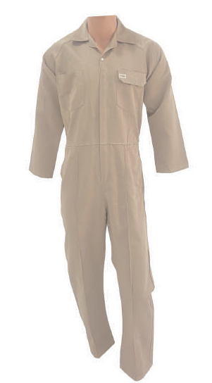
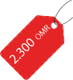
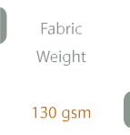

Slide 4
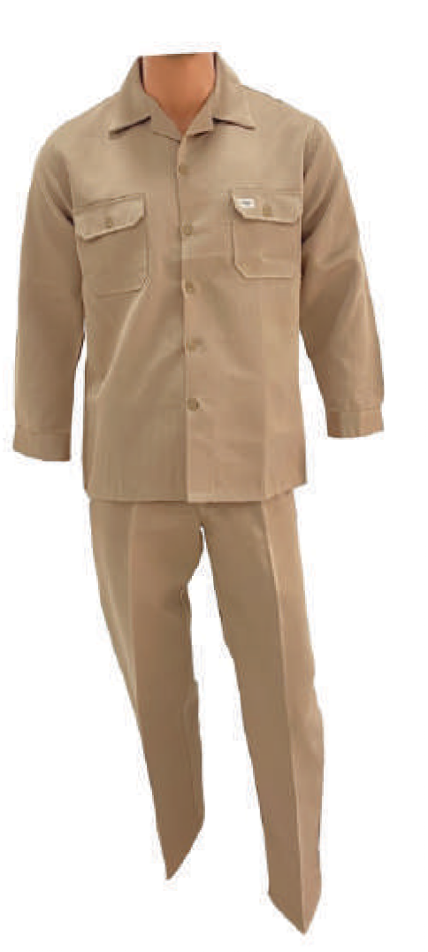
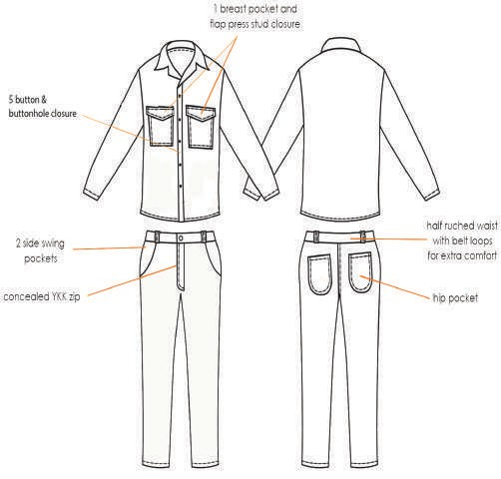
3

Slide 5
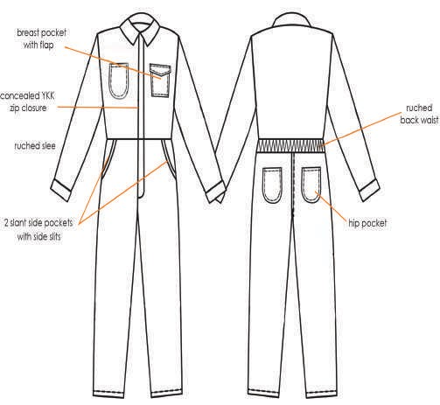
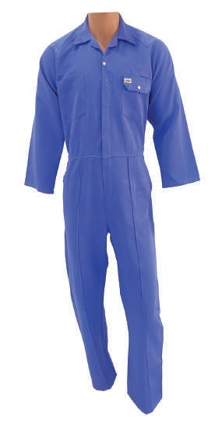
4

Slide 6
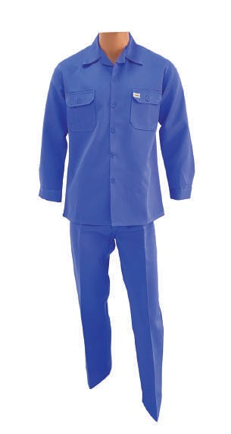
5

Slide 7
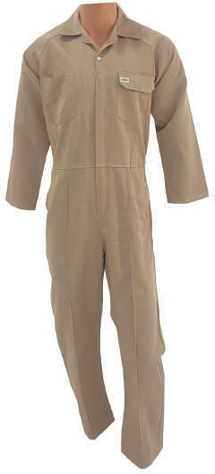
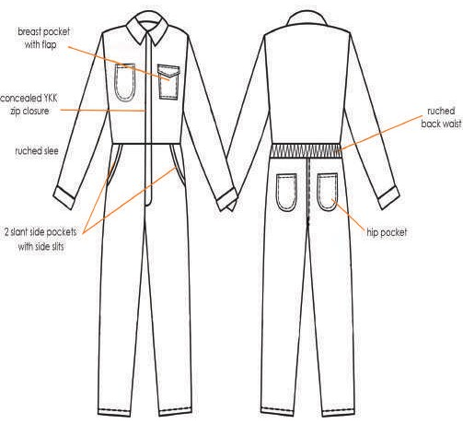
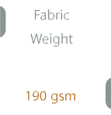
OMR
3.000
6

Slide 8
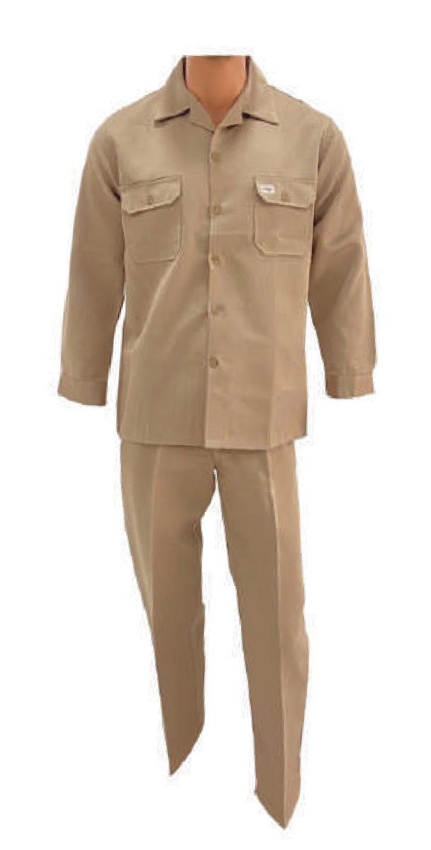
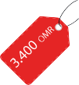
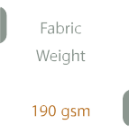

Slide 9
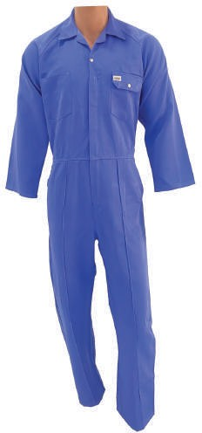

Slide 10
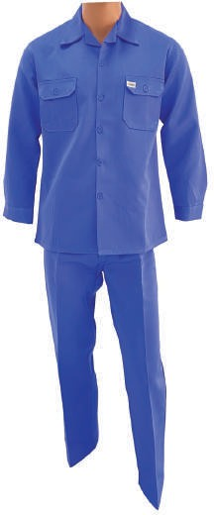

Slide 11
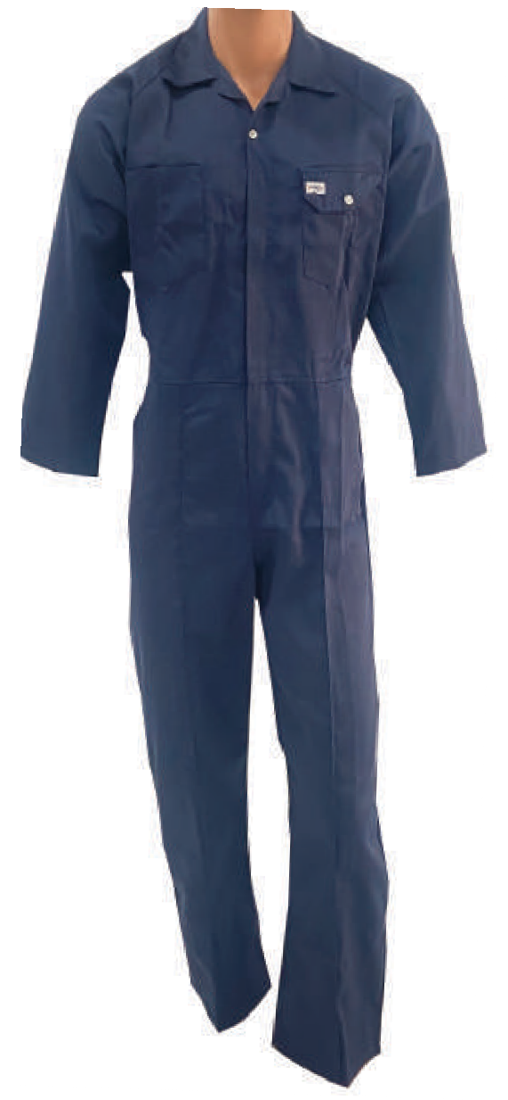

Slide 12
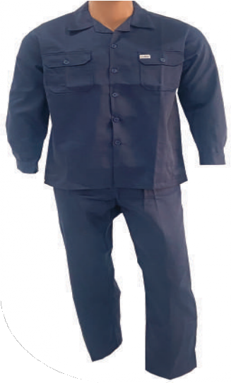

Slide 13
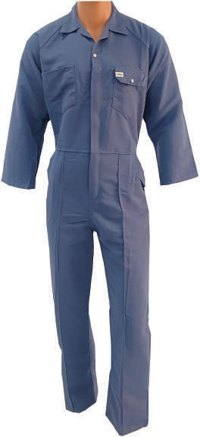

Slide 14
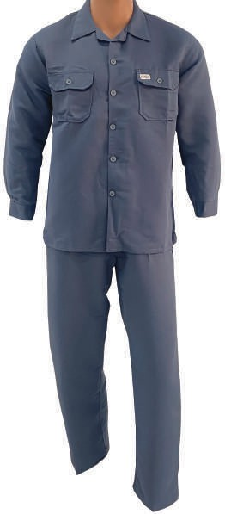

Slide 15
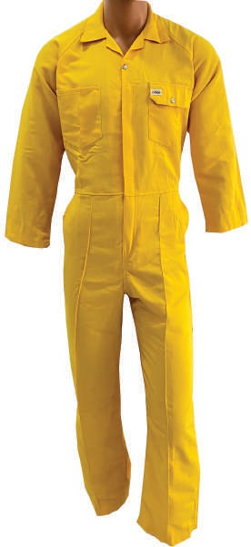

Slide 16
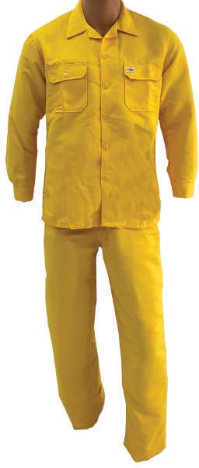

Slide 17
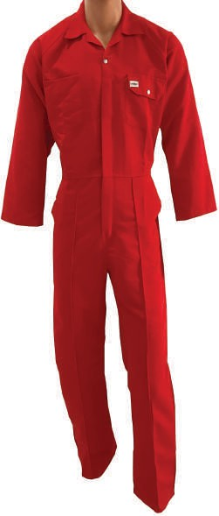

Slide 18
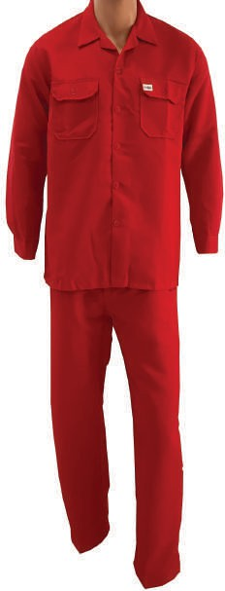

Slide 19
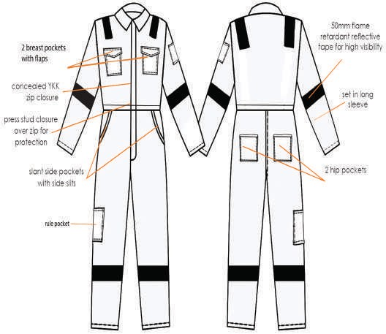
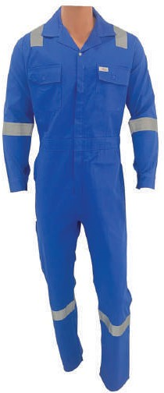
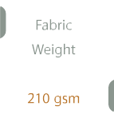

Slide 20
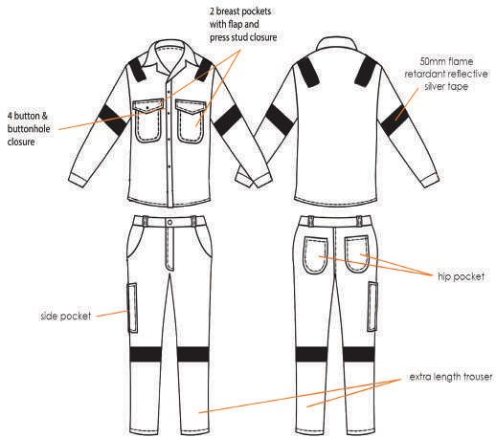
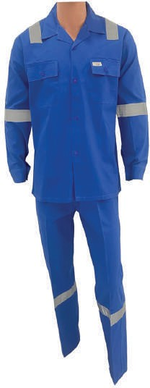

Slide 21
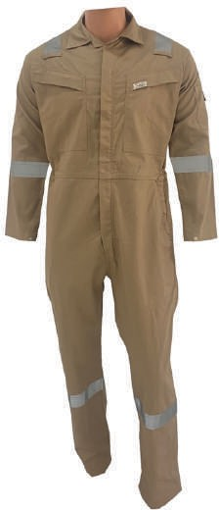
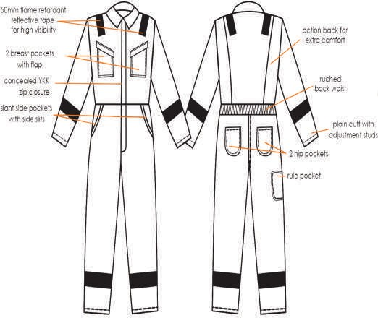
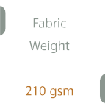

Slide 22
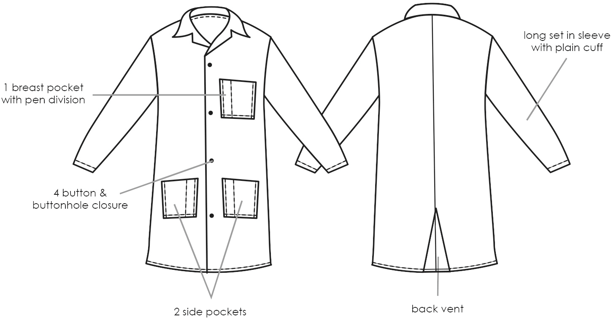
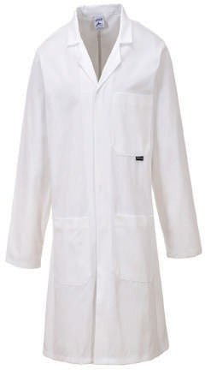

Slide 23
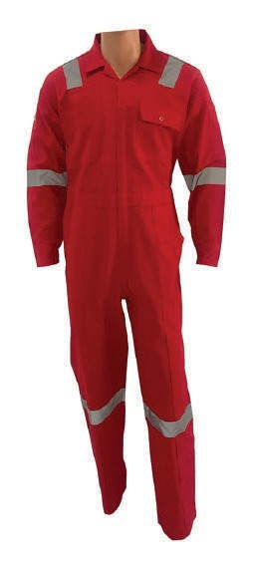
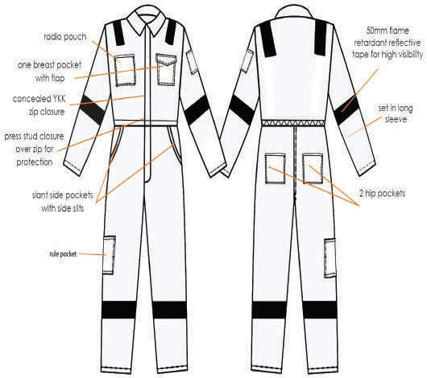
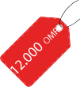
22

Slide 24
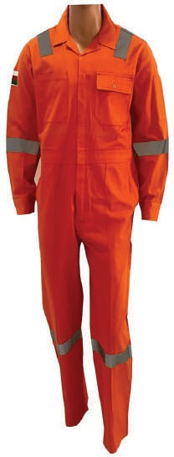
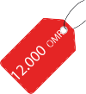

Slide 25
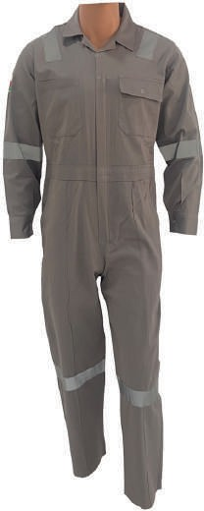

Slide 47
Safety Googles
0.500
OMR
OMR
0.400
Lens
Lens
Dark
Clear

Slide 48
Helmets
0.800
OMR
Color
Color
Color
Color
Color
Green
Yellow
Blue
White
Red

Slide 49
Worker Guardian Shoes
3.500
Made
Toe Cap
39-40-41-42-43
-44-45-46
Steel Toe Cap
China

Slide 54
Brand Name: Gloves
0.200
OMR
0.500
OMR
Type
Type Hand Glove Orange and Black Latex
Hand Glove Grey Cut Resistant
OMR
0.150
Type
Hand Glove Red and Black Nitrile

Slide 55
Brand Name: Gloves
0.150
0.100
OMR
OMR
Type
Type
Hand Glove Double Sides blue dots
Hand Glove Black one side white dots
OMR
0.500
Type
Hand Glove Green Nitrile Long Arm

Slide 61
Brand Name: SIYAB (Fire Extinguisher)
15.600
OMR
9.700
OMR
Type
Type
CO2 2 KG
CO2 5 KG

Slide 62
Brand Name: SIYAB (Fire Extinguisher)
8.000
OMR
10.700
OMR
Type
Type
FOAM 6 L
FOAM 9 L

Slide 63
Brand Name: SIYAB (Fire Extinguisher)
7.600
OMR
4.500
OMR
Type
Type
Dry POWDER 1 KG
Dry POWDER 4 KG

Slide 64
Brand Name: SIYAB (Fire Extinguisher)
8.700
OMR
11.800
OMR
Type
Type
Dry POWDER 6 KG
Dry POWDER 9 KG

Slide 65
Brand Name: SIYAB (Fire Extinguisher)
OMR
71.000
Type
Portable Dry POWDER 50 KG

Slide 66
Brand Name: Fire Extinguisher Stand Steel for 2 Cylinders
8.800
OMR
Made
Stainless Steel

Slide 67
Brand Name: Eye Wash System
OMR
75.000
Made
Stainless Steel
66

